Slide 1
E-Commerce: Regulatory, Ethical, and Social Environments

Slide 2




Learning Objectives
Understand the foundations for legal and ethical issues in EC.
Describe intellectual property law and understand its adjudication.
Explain privacy and free speech issues and their
challenges.
Describe types of fraud on the Internet and how to protect against them.
Describe the needs and methods to protect both buyers and sellers.
Describe EC-related societal issues.
Describe Green EC and IT.

Slide 3

Ethical Challenges and Guidelines
ETHICAL PRINCIPLES AND GUIDELINES
Example: Who Owns User-Generated Content?
business ethics
A form of applied ethics that examines ethical principles and moral or ethical problems that arise in a business environment
The Issues of Internet Abuse in the Workplace
Monitoring Employees—Is It Ethical?

Slide 4

Ethical Challenges and Guidelines
ethics
The branch of philosophy that deals with what is considered to be right and wrong
privacy
The right to be left alone and free of unreasonable personal intrusions

Slide 5

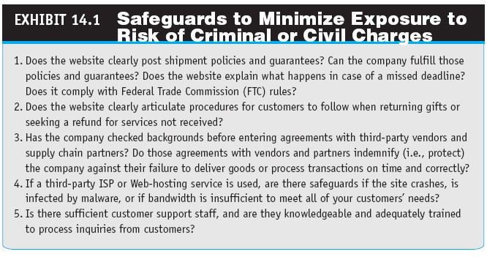

Slide 6

Ethical Challenges and Guidelines
EC ETHICAL ISSUES
Related to legal issues:
Intellectual property rights
Privacy
Free speech versus censorship
Consumer and merchant protection against fraud
Nonwork-Related Use of the Internet
Codes of Ethics

Slide 7
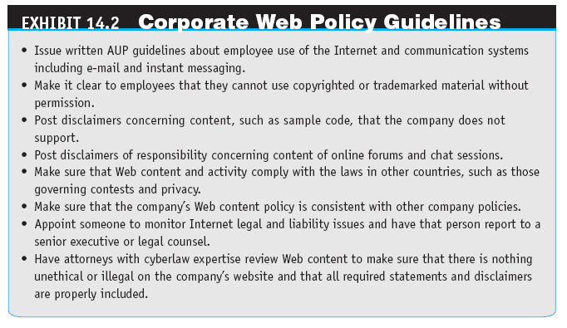

Slide 8

Intellectual Property Law
INTELLECTUAL PROPERTY IN E-COMMERCE
intellectual property(IP)
Creations of the mind, such as inventions, literary and artistic works, and symbols, names, images, and designs, used in commerce
intellectual property law
Area of the law that includes patent law, copyright law, trademark law, trade secret law, and other branches of the law such as licensing and unfair competition

Slide 9

Intellectual Property Law
copyright
An exclusive right of the author or creator of a book, movie, musical composition, or other artistic property to print, copy, sell, license, distribute, transform to another medium, translate, record, perform, or otherwise use
infringement
Use of the work without permission or contracting for
payment of a royalty

Slide 10

Intellectual Property Law
digital rights management (DRM)
An umbrella term for any of several arrangements that allow a vendor of content in electronic form to control the material and restrict its usage
fair use
The legal use of copyrighted material for noncommercial
purposes without paying royalties or getting permission
patent
A document that grants the holder exclusive rights to an invention for a fixed number of years

Slide 11

Intellectual Property Law
trademark
A symbol used by businesses to identify their goods and services; government registration of the trademark confers exclusive legal right to its use
trademark dilution
The use of famous trademarks in public that diminishes the capacity of the mark to distinguish goods or services, or tarnishes the mark in the eyes of the consumer

Slide 12

Intellectual Property Law
FAN AND HATE SITES
cyberbashing
Domain name that criticizes an organization or person

Slide 13

Privacy Rights,
Protection, and Free Speech
SOCIAL NETWORKS CHANGING THE LANDSCAPE OF PRIVACY AND ITS PROTECTION
Global View

Slide 14

Privacy Rights,
Protection, and Free Speech
PRIVACY RIGHTS AND PROTECTION
opt-out
Business practice that gives consumers the opportunity to refuse sharing information about themselves
opt-in
Agreement that requires computer users to take specific steps to allow the collection of personal information

Slide 15
Privacy Rights,
Protection, and Free Speech
FREE SPEECH ONLINE VERSUS PRIVACY PROTECTION
Free Speech Online Versus Child Protection Debate
legal precedent
A judicial decision that may be used as a standard in subsequent similar cases
THE PRICE OF PROTECTING AN INDIVIDUAL’S PRIVACY

Slide 16

Privacy Rights,
Protection, and Free Speech
HOW INFORMATION ABOUT INDIVIDUALS IS COLLECTED AND USED ONLINE
Website Registration
Cookies
spyware
All unwanted software programs designed to steal proprietary information, or that target data stores containing confidential information

Slide 17

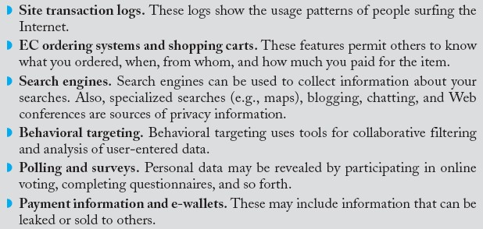
Privacy Rights,
Protection, and Free Speech
RFID’s Threat to Privacy
Other Methods
Privacy of Employees

Slide 18
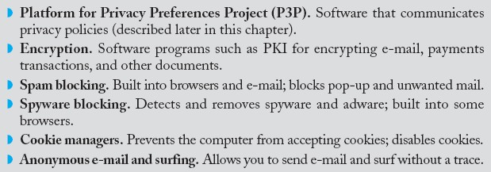
Privacy Rights,
Protection, and Free Speech
PRIVACY PROTECTION BY INFORMATION TECHNOLOGIES

Slide 19

Privacy Rights,
Protection, and Free Speech
PRIVACY ISSUES IN WEB 2.0 TOOLS AND SOCIAL NETWORKS
Presence, Location-Based Systems, and Privacy
Free Speech via Wikis and Social Networks

Slide 20

Privacy Rights,
Protection, and Free Speech
PRIVACY PROTECTION BY ETHICAL PRINCIPLES
Notice or awareness
Choice or consent
Access or participation
Integrity or security
Enforcement or redress

Slide 21

Privacy Rights,
Protection, and Free Speech
Online Privacy Clarification
The USA PATRIOT Act Versus Privacy
Government Spying on Its Citizenry
Platform for Privacy Preferences Project (P3P)
A protocol allowing websites to declare their intended use of information they collect about browsing users
PRIVACY PROTECTION IN COUNTRIES OTHER
THAN THE UNITED STATES

Slide 22

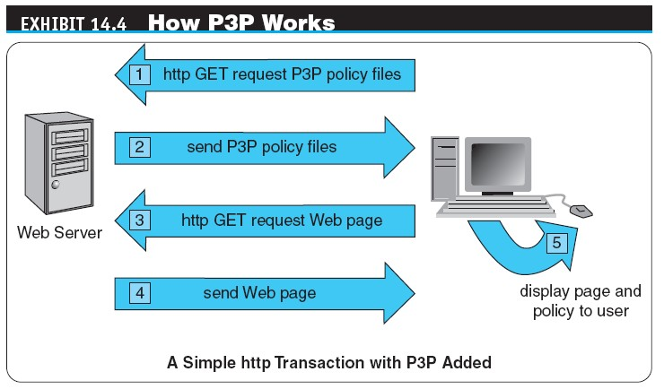

Slide 23

Other EC Legal Issues
THE LEGAL AND REGULATORY ENVIRONMENT
electronic discovery (e-discovery)
Discovery in civil litigation that deals with information in electronic format; also referred to as electronically stored information (ESI)
Types of Data E-Discovery
How Electronic Discovery Is Used
E-Discovery and Social Networks

Slide 24

Other EC Legal Issues
cyberbullying
The use of information and communication technologies to support deliberate, repeated, and hostile behavior by an individual or group, that is intended to harm others
Cyberbullying Versus CyberStalking
The Possible Damage of Cyberbulllying

Slide 25

Consumer and Seller Protection from Online Fraud
CONSUMER (BUYER) PROTECTION
Representative Tips and Sources for Your Protection
Third-Party Assurance Services
Protection by Third-Party Intermediary
TRUSTe’s “Trustmark”
Better Business Bureau
Which?
Web Trust Seal and Others
Evaluation by Consumers

Slide 26

Consumer and Seller Protection from Online Fraud
Computer Fraud and Abuse Act (CFAA)
Major computer crime law to protect government computers and other Internet-connected computers
SELLER PROTECTION
What Can Sellers Do?

Slide 27
Consumer and Seller Protection from Online Fraud
PROTECTING BUYERS AND SELLERS: ELECTRONIC AND DIGITAL SIGNATURES
electronic signature
A generic, technology-neutral term that refers to the various methods by which one can “sign” an electronic record
Authentication and Biometric Controls
Fraud Detecting Systems
GOVERNMENT REGULATION OF E-COMMERCE

Slide 28

Public Policy and Political Environments
NET NEUTRALITY APPROVED BY THE FCC
TAXATION OF EC TRANSACTIONS
taxation
The process whereby charges are imposed on individuals or property by the legislative branch of the federal government and by many state governments to raise funds for public purposes

Slide 29
Public Policy and Political Environments
INTERNET CENSORSHIP BY COUNTRIES
Internet censorship
The control or suppression of the publishing or accessing of information on the Internet

Slide 30

Public Policy and Political Environments
regulatory compliance
Systems or departments in an organization whose job is to ensure that personnel are aware of and take steps to comply with relevant laws, standards, policies, and regulations

Slide 31

Public Policy and Political Environments
International Compliance
Compliance in the United States
compliance data
Data pertaining to the enterprise included in the law that can be used for the purpose of implementing or validating compliance
Equal Opportunity and Discrimination

Slide 32
Societal Issues and Green EC
digital divide
The gap that has emerged between those who have and those who do not have the ability to use the technology
Overcoming the Digital Divide
telecommuting
Working at home using a PC and the Internet

Slide 33
Societal Issues and Green EC
Green computing
The study and practice of eco-friendly computing resources; is now a key concern of businesses in all industries—not just environmental organizations
Green IT
Begins with manufacturers producing environmentally friendly products and encouraging IT departments to consider more friendly options like virtualization, power management, and proper recycling habits

Slide 34
Societal Issues and Green EC
How to Operate Greener Businesses, Data Centers, and Supply Chains
Global Green Regulations
Electronic Product Environmental Assessment Tool (EPEAT)
A searchable database of computer hardware that meets a strict set of environmental criteria

Slide 35
Societal Issues and Green EC
OTHER SOCIETAL ISSUES
Education
Public Safety, Criminal Justice, and Homeland Security
Health Aspects

Slide 36

Managerial Issues
What legal and ethical issues should be of major concern to an EC enterprise?
What are the most critical ethical issues?
How can intellectual property rights be protected when it
comes to digital content?
How can patent costs be monitored effectively?
What is the ethical principle of protecting the privacy of
customers?
How can a company create opportunities in the global trend toward green EC?

Slide 37

Summary
Understanding legal and ethical challenges and how to contain them
Intellectual property law
Privacy, free speech, defamation, and their challenges
Fraud on the Internet and how to protect consumers against it
Protection of buyers and sellers
Societal impacts of EC
Green EC

Slide 38
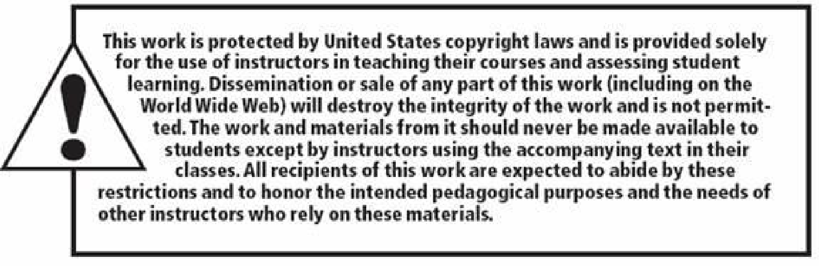




All rights reserved. No part of this publication may be reproduced, stored in a retrieval system, or transmitted, in any form or by any means, electronic, mechanical, photocopying, recording, or otherwise, without the prior written permission of the publisher. Printed in the United States of America.
Copyright © 2012 Pearson Education, Inc.
Publishing as Prentice Hall

